Slide 1
Anti-Racism in Medical Education
Georgetown University Hospital Department of Medicine Grand Rounds
February 4th, 2021
Amara Davidson, MD PGY-1
Joseph Truglio, MD MPH Program Director
Med-Peds Residency, Icahn School of Medicine at Mount Sinai
Notes:
Joe and Ann-Gel introduce ourselves

Slide 2
Acknowledgements
Sarah Baden
Ronald W Davidson
Sharon Edwards
Amy Garvey
Jill Gregory
Leona Hess
Joanne Hojsak
Gale Justin
Reena Karani
Ann-Gel Palermo
Tema Okun
Jessica Reid-Adam
Michelle Sainte
Giselle Lynch
Sharon Washington
Students of the Anti-Racism Coalition
Notes:
Acknowledge the many people contributing to this work over many years.

Slide 3
We have no conflicts of interest

Slide 4
Notes:
Every system is perfectly designed to produce the results that it gets.
Our question is what are the policies and practices that result in health inequities like those seen here?

Slide 5
By the end of this session you will be able to:
Identify the ways by which White Supremacy Culture drives health inequities
Describe a framework for anti-racist clinical skills
Enumerate techniques to foster anti-racist and anti-oppressive culture in medical education

Slide 6
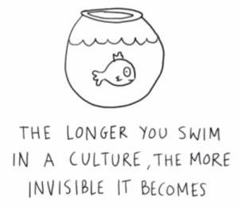
Culture
Notes:
Take a step back and talk about culture.
What comes to mind when you hear the word culture?
What about White Supremacy Culture?

Slide 7
White Supremacy Culture
Racism is a system of structuring opportunity and assigning values based on the social interpretation of how one looks.*
Racist policies and practices provide this structure, and are any policy or practice that, regardless of intent, results in a shift in power/privilege/opportunity towards those called white.
Racist policies and practices are supported by the hierarchy, values, beliefs and norms of a predominantly white culture.
This hierarchy, values, beliefs and norms are called White Supremacy Culture
We all either perpetuate White Supremacy Culture, through action or inaction, or disrupt White Supremacy Culture, through intentional actions.
*Jones CP. Confronting Institutionalized Racism. Phylon 2003;50(1-2):7-22.
Notes:
So how does white supremacy culture relate to racism?

Slide 8
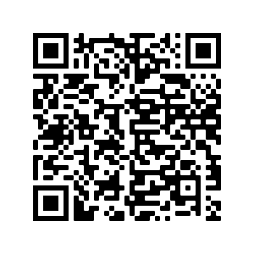
White Supremacy
Either-or thinking
Power hoarding
Defensiveness
Focus on individuality
Right to comfort
Worship of the written word
https://www.dismantlingracism.org/
Notes:
Give overview of white supremacy norms.
Have folks scan the QR code.
Set up think-pair-share:
Everyone think about ONE of these norms they often see at play in the hospital. Consider:
How does this norm impact my patients?
How does this norm impact me?
How, specifically have I CONTRIBUTED to this norm?

Slide 9
Anti-Racism in Medical Education
Curriculum
Faculty Development
Is faculty time for development in anti-racist skills valued?
Program Structure
Who decides program mission and design?
Relationships
Is power explicitly recognized in interpersonal AND program-community relationships?
Which voices are not represented in program power structures?
Is the expectation for anti-racism distributed equitably across faculty? Or is there a burden placed on faculty of color?
Are these knowledge and skills pro-actively included throughout the program curriculum, or delivered in a reactionary manner or as isolated sessions?
Are anti-racist knowledge and skills developed to meet specific competencies that are related to the program mission?
Do recruitment goals and metrics reflect the program mission, developed via anti-racist methods?
Are White faculty developed on how to mentor trainees of color?
Is the racist ecosystem within which relationships exist recognized and challenged?
Notes:
What are the policies and practices that result in racial inequities in each of these domains of medical education?
What are the white supremacy norms that perpetuate these policies and practices?

Slide 10
Anti-Racism in Medical Education
Curriculum
Faculty Development
Is faculty time for development in anti-racist skills valued?
Program Structure
Who decides program mission and design?
Relationships
Is power explicitly recognized in interpersonal AND program-community relationships?
Which voices are not represented in program power structures?
Is the expectation for anti-racism distributed equitably across faculty? Or is there a burden placed on faculty of color?
Are these knowledge and skills pro-actively included throughout the program curriculum, or delivered in a reactionary manner or as isolated sessions?
Are anti-racist knowledge and skills developed to meet specific competencies that are related to the program mission?
Do recruitment goals and metrics reflect the program mission, developed via anti-racist methods?
Are White faculty developed on how to mentor trainees of color?
Is the racist ecosystem within which relationships exist recognized and challenged?

Slide 11
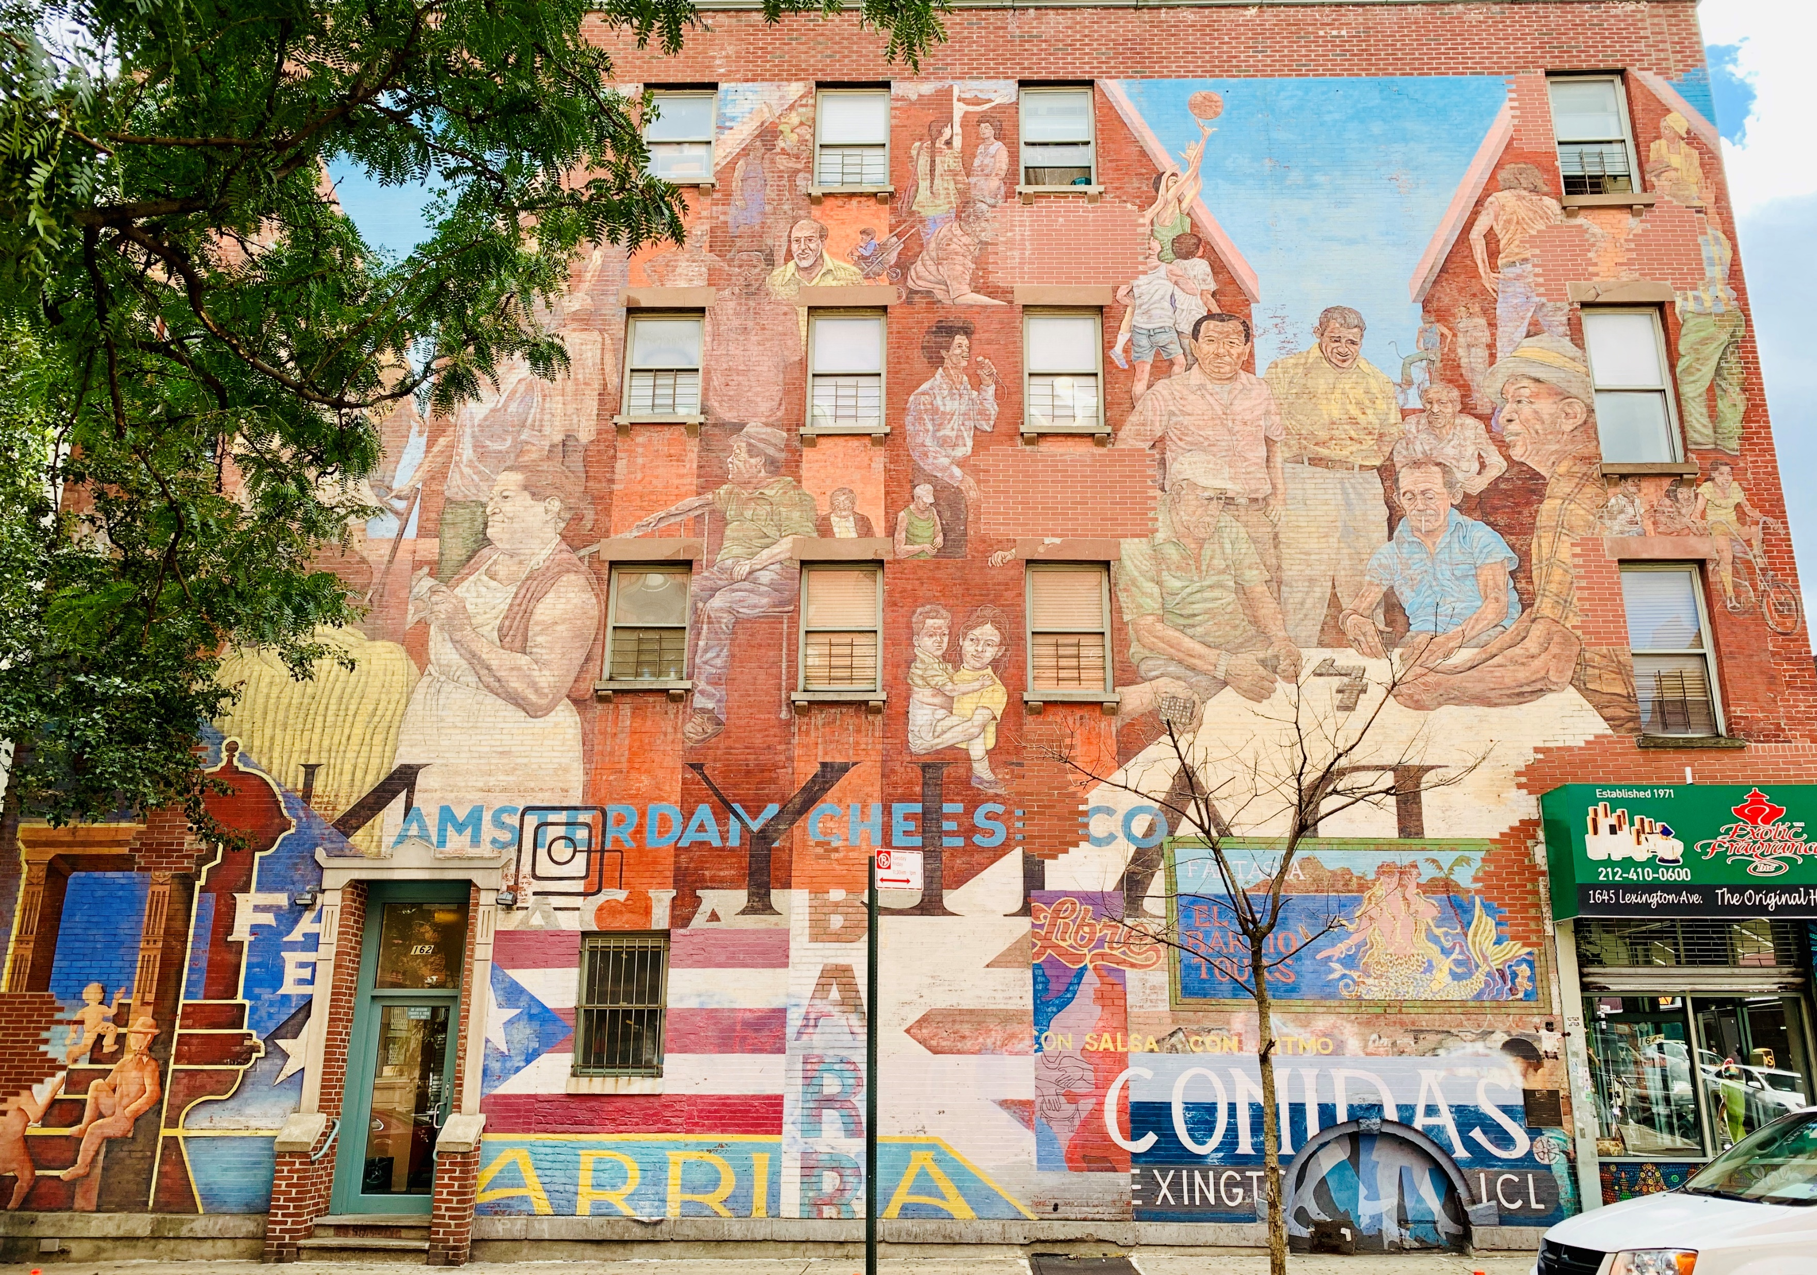
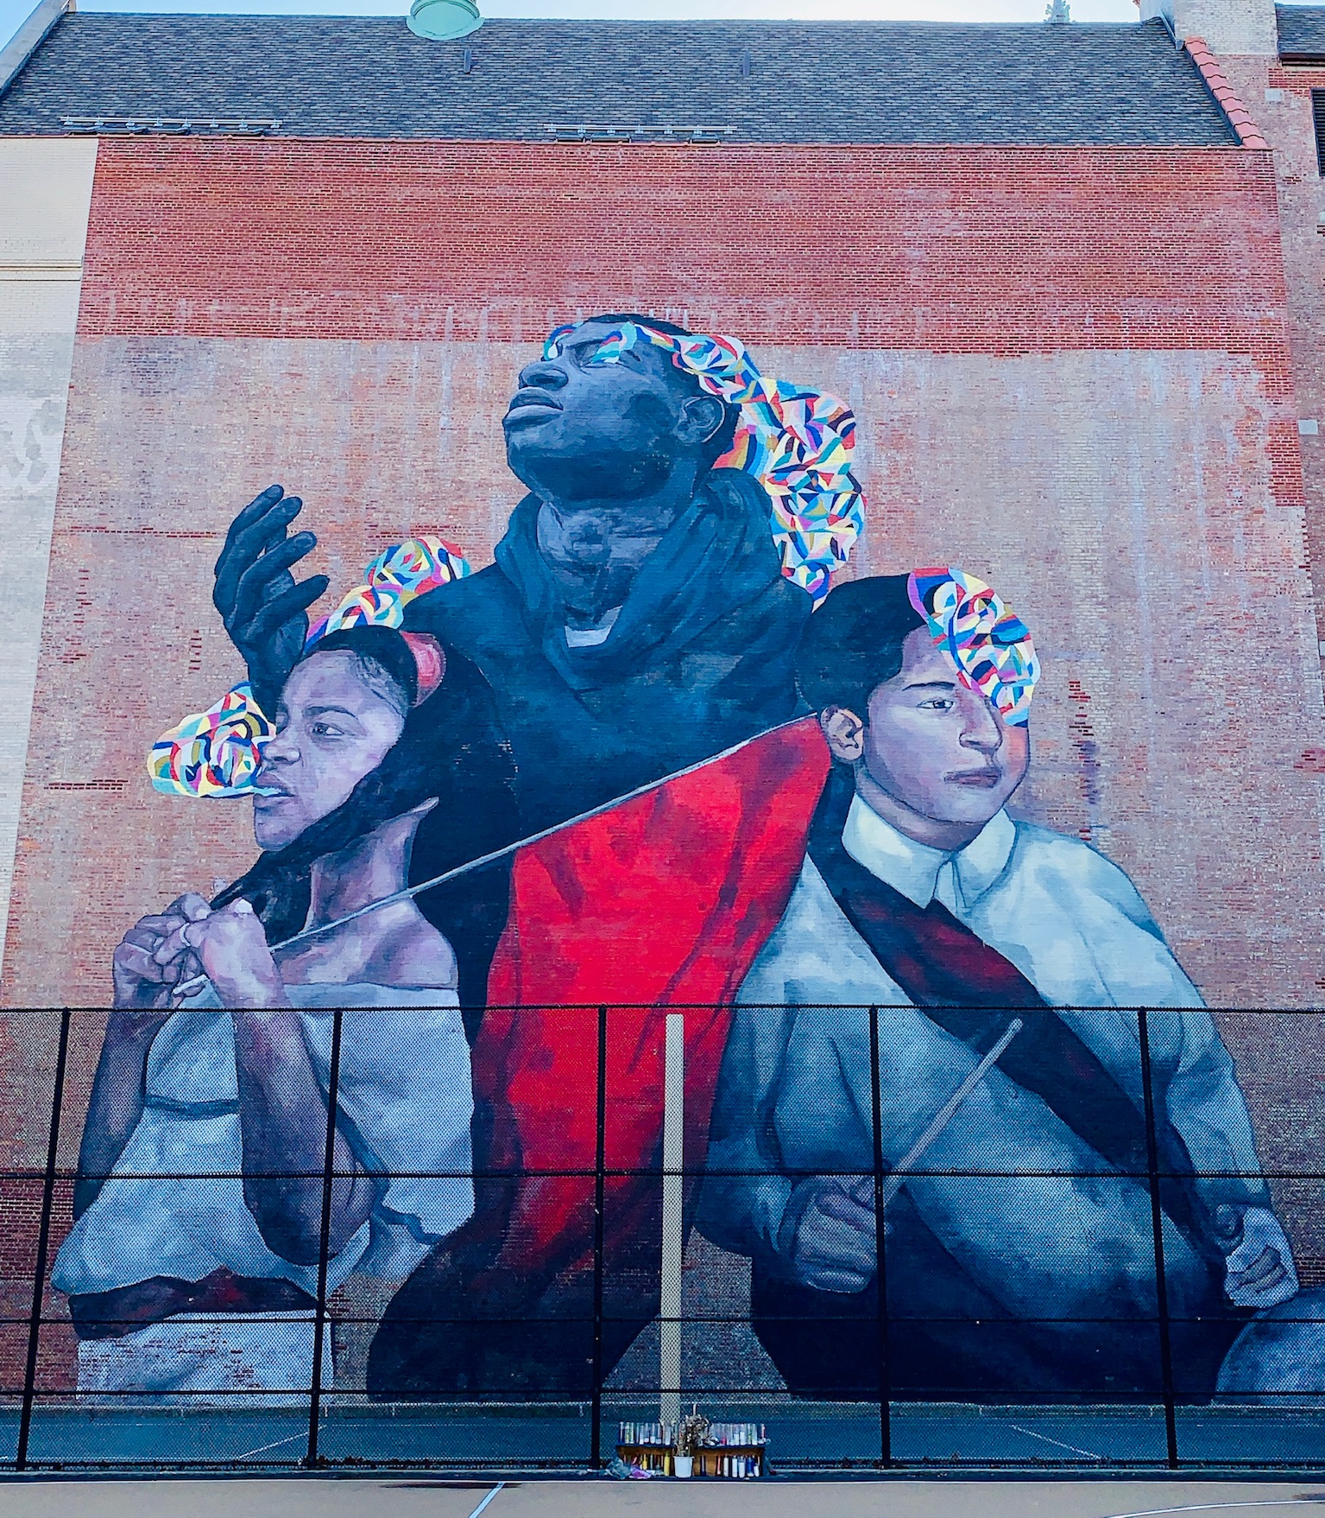
Program Structure
Our aim is to shift power in residency recruitment and training away solely from the academic medical center to the patients and communities that will be cared for by and participate in the training of residents.

Slide 12
Program Structure
Mission
Recruitment
Curriculum
Evaluation

Slide 13
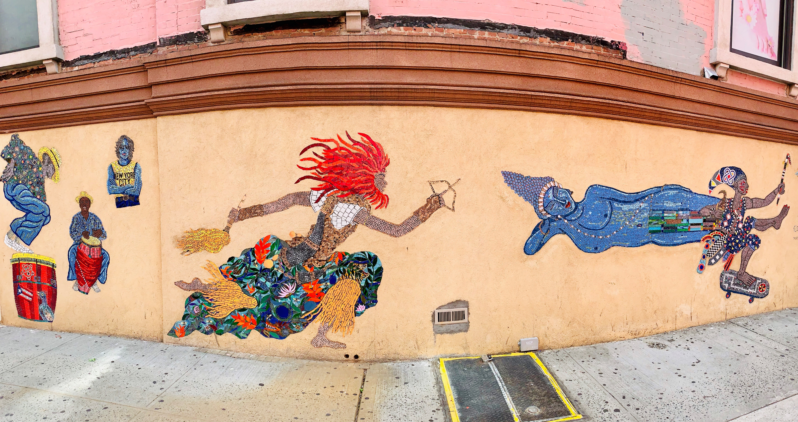
Program Structure
Program Advisory Board
Recruitment Committee
Evaluation Committee

Slide 14
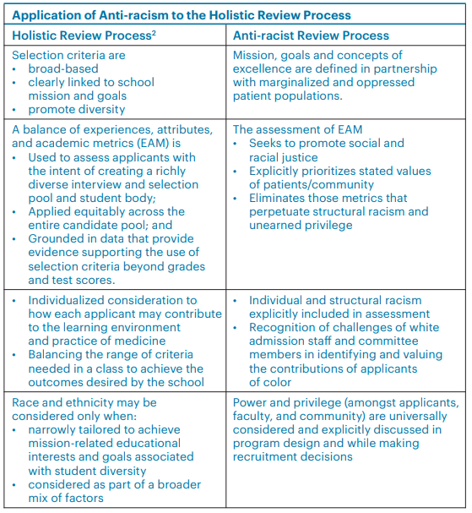
Mission statement developed in collaboration with community and patients. Metrics follow from this.
Primary care and social justice are dual priorities
AOA, Board Scores blinded. Clerkship grades, schools de-emphasized.
Recruitment committee reflects power sharing, including physicians, SW, RN, chaplains, patients and community leaders.
Extensive development on anti-oppressive techniques
Truglio, J, Palermo, A., Hess, L., Dennar, P., Eyssallenne, A. (2020) Developing an Anti-Racist Residency Recruitment Process. SGIM Forum 43 (1): 4-5, 16.

Slide 15
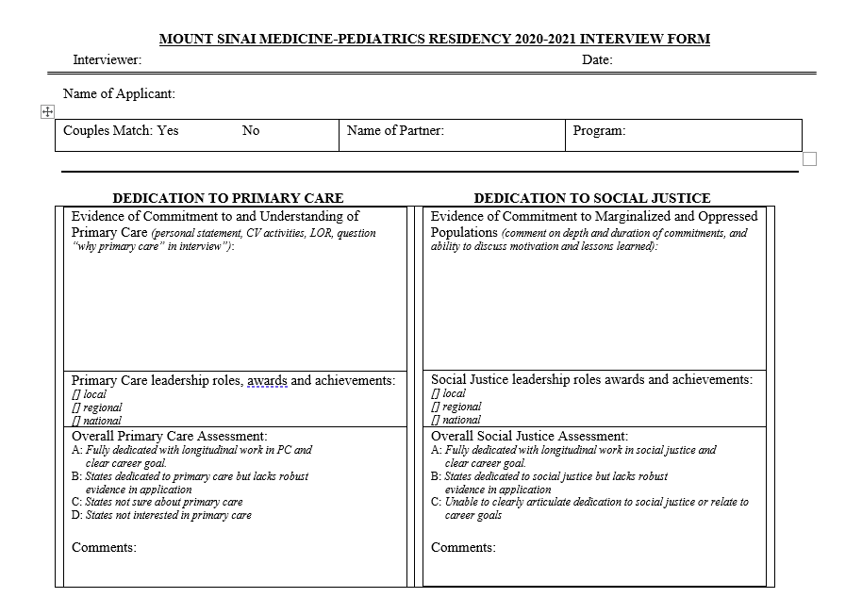

Slide 16
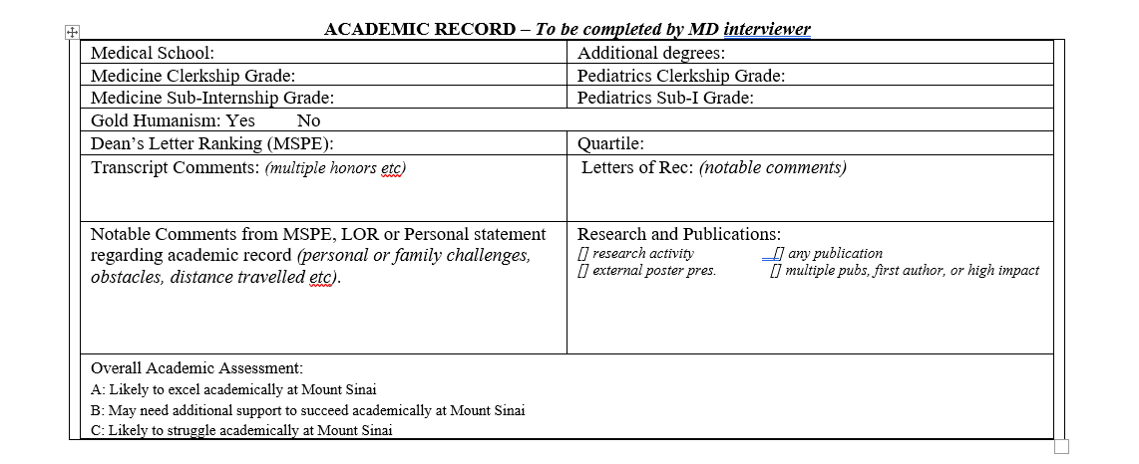

Slide 17
Anti-Oppressive Skills
Mitigates and interrupts social power dynamics.
Ensures that everyone gets to participate and share ideas, not just those who feel most comfortable speaking up
Helps prevent or interrupt any (conscious or unconscious) attempts by individuals or groups to overpower the group.
Points out and addresses discrepancies in who is talking/whose voices are being heard.
Helps people keep an eye on what’s best for the group, rather than their personal preference.
Aorta.coop
This Photo by Unknown Author is licensed under CC BY-SA-NC
Notes:
Link to white supremacy culture

Slide 18
White Supremacy Cultural Norm | Manifestation in Educational/Clinical Space | Anti-Oppressive Facilitation Techniques
Power hoarding | Individuals with traditional power in society (White people, cis-gender men) speak more and are recognized more than others, interrupt others in the group, or re-state what others have said. | Use techniques such as “think-pair-share,” waiting 30 seconds prior to hearing response etc. to create space for those not being heard. Name what you observe: “I have noticed that comments are often being restated by men before being acknowledged by the group.” Synthesize comments/statements marginalized/oppressed voices in the room, and ask those individuals if your synthesis is correct.
Right to comfort | Racist statements, including those that unintentionally perpetuate racist ideologies and scientific racism, go unchallenged, and are therefore assumed to be acceptable/true. There is a fear of making individuals, particularly white men, uncomfortable. The burden of challenging racist ideas remains with members of the marginalized group. | Establish a culture of growth at the start of each block. This includes concepts of supporting individual growth while challenging ideas. Name what you observe: “I have noticed that only people of color have shared their thoughts about racism in this case.”

Slide 19
White Supremacy Cultural Norm | Manifestation in Educational/Clinical Space | Anti-Oppressive Facilitation Techniques
Supremacy of the written word | Published articles, textbooks and guidelines are viewed as the only or the primary source of knowledge and truth. Their conclusions are not challenged. Perspectives or marginalized and oppressed communities are not heard. | Intentionally include diverse perspectives (patients, communities). Model thoughtful critique of bodies of scientific knowledge. Challenge scientific racism, and “name those who do the writing.”
Either-or thinking | Participants are viewed as “either vocal or not participating.” Participants struggle to identify racist policies and practices out of fear of “labeling someone/something racist.” Debate over “is this racist or not.” | Recognize that there are many forms of participating. Describe these at the start of a session and create opportunities for learners to participate. Recognize that racism and oppression are ever-present, and focus the discussion on consequences and intent of individual policies and practices.

Slide 20
Anti-Racism in Medical Education
Curriculum
Faculty Development
Is faculty time for development in anti-racist skills valued?
Program Structure
Who decides program mission and design?
Relationships
Is power explicitly recognized in interpersonal AND program-community relationships?
Which voices are not represented in program power structures?
Is the expectation for anti-racism distributed equitably across faculty? Or is there a burden placed on faculty of color?
Are these knowledge and skills pro-actively included throughout the program curriculum, or delivered in a reactionary manner or as isolated sessions?
Are anti-racist knowledge and skills developed to meet specific competencies that are related to the program mission?
Do recruitment goals and metrics reflect the program mission, developed via anti-racist methods?
Are White faculty developed on how to mentor trainees of color?
Is the racist ecosystem within which relationships exist recognized and challenged?

Slide 21
Patient #1
RW is a 42-year-old cis-gender man with hypertension and type-2 diabetes. He presented to our office after being lost to follow-up for several years. During this time he describes severe depression and significant alcohol use in the years after his son was killed by a stray bullet while outside with his friends.
On initial labs his creatinine is 5.5mg/dl. After establishing care with nephrology he was started on hemodialysis. Five years later he has not received a kidney transplant or been offered peritoneal dialysis, has developed atrial fibrillation, two GI bleeds, a DVT, and has lost multiple A-V fistulas.

Slide 22
Framework for Anti-Racist Clinical Skills Development
Remember that you cannot get from race to inequity without racism
1
Focus on consequences, not intent, of policies and practices
2
Link racist policies and practices to White Supremacy norms
3
Develop anti-racist clinical skills to dismantle these norms
4
Notes:
Present this framework for disrupting white supremacy norms.
This framework focuses on skills to reduce racial inequities in patients (similar framework for teams)

Slide 23
Application to ESRD
ESRD
Segregated Care
Scientific Racism
Clinician Implicit Racism
Notes:
This depicts a few select drivers of racial inequities observed in SLE outcomes, specifically in incidence of ESRD.
Some contributing factors include segregated care, scientific racism and
Segregated care results in poorer access to timely diagnosis and management.
Scientific racism manifests in this case as false beliefs in racial differences in estimated GFR, resulting in delayed referrals to nephrology and increased exposure to nephrotoxic agents and/or doses.
Individual clinician racism impacts our interpretation of presenting symptoms, resulting in delayed diagnosis and treatment.

Slide 24
Application to ESRD
Supremacy of the Written Word
ESRD
Segregated Care
Scientific Racism
Clinician Implicit Racism
Power Hoarding
Right to comfort; defensiveness
Notes:
In turn, each of these racist policies and practices are supported by white supremacy norms.
These norms can be identified and challenged on multiple levels, depending on your sphere of influence.
Segregated care is supported by economic and financial power hoarding. This can be challenged at the systems-level by changing economic and reimbursement systems or by pressuring/shaming health systems such that it is not economically “worth it” to continue segregated care. On the individual level, individual clinicians can provide enhanced access to individual patients. Both strategies are examples of power sharing.
Scientific racism is supported by superiority of the written word, wherein medical practices grounded in “published data” are upheld even when these data are false. Inclusion of alternative knowledge (from patients and communities who do not typically participate in creation of scientific literature, and/or from newer data to challenge tradition) can challenge scientific racism. This can be done at the systems level by advocating for removal of the race coefficient in hospital system and national labs, and on the individual level by clinicians ignoring the race co-efficient for individual patients.
Clinician implicit bias (especially around pain in the case of SLE) is perpetuated by the white supremacy norm of the right to comfort. It is challenged on the individual level when we as individual clinicians explore and mitigate our own biases and those of our colleagues. Addressing clinician implicit bias at the policy level includes putting policies in place that mitigate the impact of implicit bias on clinical outcomes (policies that encourage DEI, for example), policies that

Slide 25
Application to ESRD
Supremacy of the Written Word
Advocacy and Policy
ESRD
Segregated Care
Scientific Racism
Clinician Implicit Racism
Power Hoarding
Right to comfort; defensiveness
Anti-Racist Bedside Skills
Notes:
In turn, each of these racist policies and practices are supported by white supremacy norms.
These norms can be identified and challenged on multiple levels, depending on your sphere of influence.
Segregated care is supported by economic and financial power hoarding. This can be challenged at the systems-level by changing economic and reimbursement systems or by pressuring/shaming health systems such that it is not economically “worth it” to continue segregated care. On the individual level, individual clinicians can provide enhanced access to individual patients. Both strategies are examples of power sharing.
Scientific racism is supported by superiority of the written word, wherein medical practices grounded in “published data” are upheld even when these data are false. Inclusion of alternative knowledge (from patients and communities who do not typically participate in creation of scientific literature, and/or from newer data to challenge tradition) can challenge scientific racism. This can be done at the systems level by advocating for removal of the race coefficient in hospital system and national labs, and on the individual level by clinicians ignoring the race co-efficient for individual patients.
Clinician implicit bias (especially around pain in the case of SLE) is perpetuated by the white supremacy norm of the right to comfort. It is challenged on the individual level when we as individual clinicians explore and mitigate our own biases and those of our colleagues. Addressing clinician implicit bias at the policy level includes putting policies in place that mitigate the impact of implicit bias on clinical outcomes (policies that encourage DEI, for example), policies that

Slide 26
Application to ESRD
Pt. Centered Com Skills
Critical Appraisal
Supremacy of the Written Word
ESRD
Segregated Care
Scientific Racism
Clinician Implicit Racism
Power Hoarding
Right to comfort; defensiveness
Notes:
In turn, each of these racist policies and practices are supported by white supremacy norms.
These norms can be identified and challenged on multiple levels, depending on your sphere of influence.
Segregated care is supported by economic and financial power hoarding. This can be challenged at the systems-level by changing economic and reimbursement systems or by pressuring/shaming health systems such that it is not economically “worth it” to continue segregated care. On the individual level, individual clinicians can provide enhanced access to individual patients. Both strategies are examples of power sharing.
Scientific racism is supported by superiority of the written word, wherein medical practices grounded in “published data” are upheld even when these data are false. Inclusion of alternative knowledge (from patients and communities who do not typically participate in creation of scientific literature, and/or from newer data to challenge tradition) can challenge scientific racism. This can be done at the systems level by advocating for removal of the race coefficient in hospital system and national labs, and on the individual level by clinicians ignoring the race co-efficient for individual patients.
Clinician implicit bias (especially around pain in the case of SLE) is perpetuated by the white supremacy norm of the right to comfort. It is challenged on the individual level when we as individual clinicians explore and mitigate our own biases and those of our colleagues. Addressing clinician implicit bias at the policy level includes putting policies in place that mitigate the impact of implicit bias on clinical outcomes (policies that encourage DEI, for example), policies that

Slide 27
Application to ESRD
Supremacy of the Written Word
ESRD
Segregated Care
Scientific Racism
Clinician Implicit Racism
Anti-Racist Clinical Skills
Power Hoarding
Right to comfort; defensiveness
Anti-Oppressive Leadership
Notes:
In turn, each of these racist policies and practices are supported by white supremacy norms.
These norms can be identified and challenged on multiple levels, depending on your sphere of influence.
Segregated care is supported by economic and financial power hoarding. This can be challenged at the systems-level by changing economic and reimbursement systems or by pressuring/shaming health systems such that it is not economically “worth it” to continue segregated care. On the individual level, individual clinicians can provide enhanced access to individual patients. Both strategies are examples of power sharing.
Scientific racism is supported by superiority of the written word, wherein medical practices grounded in “published data” are upheld even when these data are false. Inclusion of alternative knowledge (from patients and communities who do not typically participate in creation of scientific literature, and/or from newer data to challenge tradition) can challenge scientific racism. This can be done at the systems level by advocating for removal of the race coefficient in hospital system and national labs, and on the individual level by clinicians ignoring the race co-efficient for individual patients.
Clinician implicit bias (especially around pain in the case of SLE) is perpetuated by the white supremacy norm of the right to comfort. It is challenged on the individual level when we as individual clinicians explore and mitigate our own biases and those of our colleagues. Addressing clinician implicit bias at the policy level includes putting policies in place that mitigate the impact of implicit bias on clinical outcomes (policies that encourage DEI, for example), policies that

Slide 28
Application to ESRD
Pt. Centered Com Skills
Critical Appraisal
Supremacy of the Written Word
Advocacy and Policy
ESRD
Segregated Care
Scientific Racism
Clinician Implicit Racism
Anti-Racist Clinical Skills
Power Hoarding
Right to comfort; defensiveness
Anti-Racist Bedside Skills
Anti-Oppressive Leadership
Notes:
In turn, each of these racist policies and practices are supported by white supremacy norms.
These norms can be identified and challenged on multiple levels, depending on your sphere of influence.
Segregated care is supported by economic and financial power hoarding. This can be challenged at the systems-level by changing economic and reimbursement systems or by pressuring/shaming health systems such that it is not economically “worth it” to continue segregated care. On the individual level, individual clinicians can provide enhanced access to individual patients. Both strategies are examples of power sharing.
Scientific racism is supported by superiority of the written word, wherein medical practices grounded in “published data” are upheld even when these data are false. Inclusion of alternative knowledge (from patients and communities who do not typically participate in creation of scientific literature, and/or from newer data to challenge tradition) can challenge scientific racism. This can be done at the systems level by advocating for removal of the race coefficient in hospital system and national labs, and on the individual level by clinicians ignoring the race co-efficient for individual patients.
Clinician implicit bias (especially around pain in the case of SLE) is perpetuated by the white supremacy norm of the right to comfort. It is challenged on the individual level when we as individual clinicians explore and mitigate our own biases and those of our colleagues. Addressing clinician implicit bias at the policy level includes putting policies in place that mitigate the impact of implicit bias on clinical outcomes (policies that encourage DEI, for example), policies that

Slide 29
Approach to Articles that Use Race as a Variable
Article Uses Race
SocialPolitical Construct
Valid
Not Valid
Biologic Construct
Valid
Use of Race?
Construct
Methods
Application
Not Valid
Discard
Challenge
Apply
Modify
This Photo by Unknown Author is licensed under CC BY-NC-ND
Notes:
Include patient perspective

Slide 30
Implicit Bias in the Clinical Encounter

Slide 31
5-Step Microskills Model of Clinical Teaching
Get a Commitment
Probe for supporting Evidence
Reinforce What was done right
Correct Mistake
Teach a general principle
Neber J, et al. A Five-Step “Microskills” Model of Clinical Teaching. JABFP 1992.
Notes:
Emphasize that what designed for a clinician educator, these can be used by ANY member of the team.
Do not need to use them all at once, can pick any and pose questions.

Slide 32
5-Step Microskills Model of Clinical Teaching
Get a Commitment
Guide learner to verbalize thoughts. Ask questions to support self-inquiry
“Walk me through your reasoning here.”
“What did you mean by that?”
“Can you tell me more about that?”
Recognize potential biases at play in yourself
Neber J, et al. A Five-Step “Microskills” Model of Clinical Teaching. JABFP 1992.

Slide 33
5-Step Microskills Model of Clinical Teaching
Probe for supporting Evidence
Identify dominant narratives at play
“Are there any characteristics of the patient that could be influencing our clinical reasoning here?”
“Would we come to the same decision if this patient were white/a man/etc”
Explore structural racism at play (clinical tools, structural barriers)
“What are the data supporting our clinical decisions here?”
Neber J, et al. A Five-Step “Microskills” Model of Clinical Teaching. JABFP 1992.

Slide 34
Patient #2
A six-year-old girl presents to our office with abdominal pain. Her father reports they visited the emergency room twice in last 36 hours with this symptom.

Slide 36
Scientific Racism Influences Clinical Reasoning and Medical Practice
JAMA Pediatr. 2015 Nov; 169(11): 996–1002.

Slide 37
Observable Clinical Skills and Self Reflection
Power Sharing
Asks patient priorities for visit/relationship
Systems and Complex Thinking
Asks patient about barriers to goals
Challenges Right to Comfort
Asks about experiences of racism in healthcare
Challenges Written Word
Challenges Scientific Racism
Elicits patient/community perception of health
Elicits patient/community strengths

Slide 38
By the end of this session you will be able to:
Describe the ways by which White Supremacy Culture drives health inequities
Describe a framework for anti-racist clinical skills
Enumerate techniques to foster anti-racist and anti-oppressive culture in medical education

Slide 39
5-Step Microskills Model of Clinical Teaching
Reinforce What was done right
Identification of health inequity
"It's good you recognized that patients who identify or are percieved to be Black are often placed at higher risk for poor cardiovascular outcomes, but..."
Recognition of clinical problem
Neber J, et al. A Five-Step “Microskills” Model of Clinical Teaching. JABFP 1992.

Slide 40
5-Step Microskills Model of Clinical Teaching
Correct Mistakes
Ensure that racism and not race is recognized as the driver of inequity
Model your own techniques/verbalize your own biases
"I have recognized I spend less time rounding on patients of color struggling with pain. As a team let's make sure we hole each other accountable here.“
Be concrete
Neber J, et al. A Five-Step “Microskills” Model of Clinical Teaching. JABFP 1992.

Slide 41
5-Step Microskills Model of Clinical Teaching
Teach a general principle
Develop in advance
It’s ok to circle back later with more information
It’s ok to set expectations for the team to learn together
Neber J, et al. A Five-Step “Microskills” Model of Clinical Teaching. JABFP 1992.

Slide 42
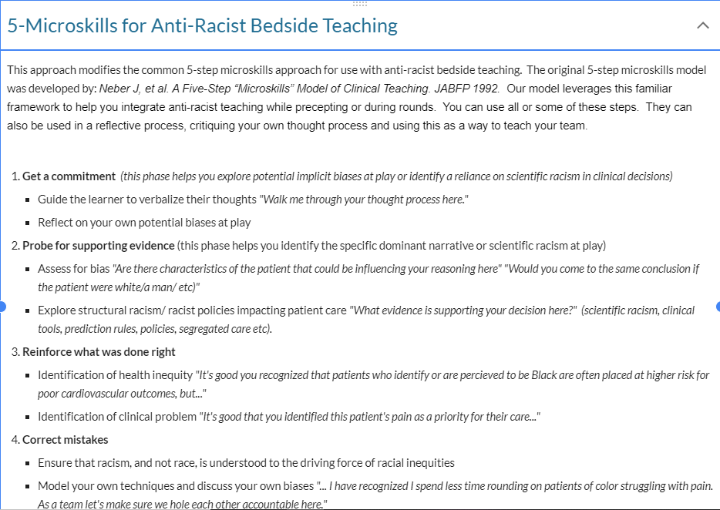
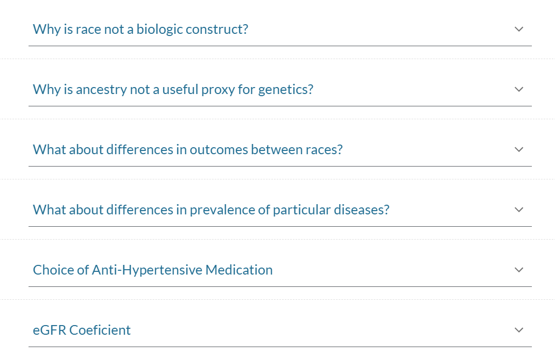
Point-of-Care Resources

Slide 43
Team Culture

Slide 44
Framework for Anti-Racist Leadership Skills Development
Remember White Supremacy norms are ubiquitous in clinical and educational spaces
1
Focus on consequences, not intent, of policies and practices
2
Recognize these norms at play around and within us
3
Develop anti-racist leadership skills to dismantle these norms
4
Notes:
Present this framework for disrupting white supremacy norms in teams.

Slide 45
Application of Anti-Racist Leadership to Team Culture
Oppressive Team Culture
Only some team members heard
Scientific Racism
Oppressive statements unchallenged

Slide 46
Application of Anti-Racist Structural Competency to ESRD
Supremacy of the Written Word
Oppressive team culture
Only some team members heard
Scientific Racism
Oppressive statements unchallenged
Power Hoarding
Right to comfort

Slide 47
The first step is recognition
Racist Patient Behavior
Overt racism
Obvious Comments/Actions
Microagressions

Slide 48
Racist Patient Behavior
Problem | Example | Message
Inferiority of racial/ethnic minorities | “Can I speak to the doctor” “Are you the nurse” | Non-white people, particularly African Americans and Latinos, cannot be physicians
Racial and gender stereotype | “Hi, Susan” (Dr. Smith) | Non-white physicians are not worthy of respect
Assigning intelligence | “You’re so articulate.” | People of color assumed to be inferior in intelligence.
Othering | “Where are you from?” “Your English is good.” | Inquiry into racial/ethnic background that implies that person is not part of the dominant culture
Racial unconscious bias and stereotyping | Patient only addressing or making eye contact with white providers on the team | Non-white physicians and trainees are not worthy of respect
Giselle Lynch, Princess Dennar
Notes:
Giselle

Slide 49
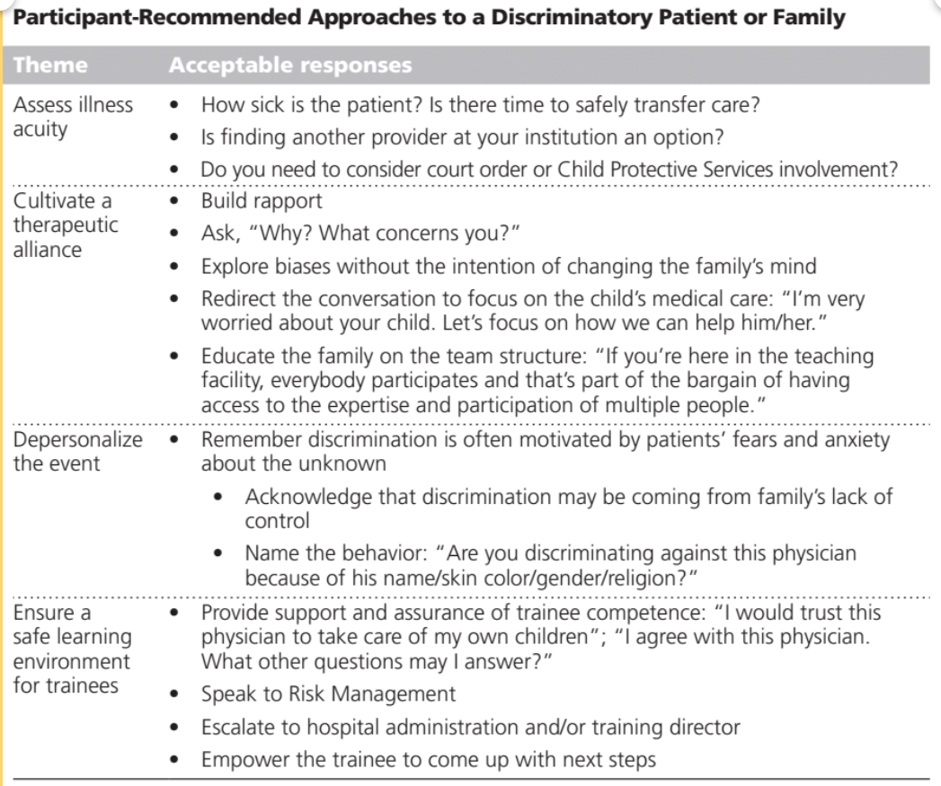
Navigating Biased Patient Behavior
Whitgob et al Acad Med 2016

Slide 50
Navigating Biased Patient Behavior
Assess illness acuity
Cultivate therapeutic alliance
Depersonalize the event
Ensure a safe learning environment

Slide 51
The “ERASE” Model
Expect
Recognize
Address
Support
Establish/Encourage

Slide 52
Medicine and Race

Slide 53
Race as a biologic construct is ubiquitous in clinical decision tools and guidelines
Glomerular filtration rate
Cardiovascular risk
Pulmonary function tests
Transplant medications
Colon and prostate cancer screening
Notes:
Say It is also important to note is that scientific racism is not an isolated event NOR is it a concept from the past. Race is used as a biologic construct to support differences in treatment and prognosis in every field in medicine.

Slide 54
Racism as Ubiquitous in Medicine
Institutional Explicit
Policies that explicitly discriminate against a group
Example: Faculty practice vs Clinic-based system
Institutional Implicit
Policies that negatively impact one group unintentionally
Example: Use of race embedded in clinical prediction rules
Individual Explicit
Prejudice in action – discrimination
Example: Doctor states “these Mexicans are a waste of resources” while rounding on a patient in alcohol withdrawal
Individual Implicit
Unconscious attitudes and beliefs
Example: Doctor spends less time with patients of color compared with white patients

Slide 55
“This is a 40-year-old Hispanic woman with multiple prior urgent visits for ’total body pain’ here for chest pain. She’s been worked up in the past for CAD and GERD with no abnormal findings, and I saw in your last note you referred her to psychiatry. I told her we really can’t do anything else for her here until she sees psychiatry.”

Slide 56
“

Slide 57
Possible Mitigating Techniques
Explicit bias in learner
Address directly – “It sounds like you relate the patient’s race or culture to her experience of pain?”
Probe how the bias may impact patient care – “How might this impact your pain assessment?”
Probe for or suggest alternative understanding – “Why else might the patient seem ‘over dramatic?’ Is there anything we could be missing?”
You sense your own bias may impact cognitive error
Think out loud
“I often associated a patient in chronic pain with drug seeking. Whenever I catch myself doing this I need to slow down and be sure to gather more data.”
Clinician selectively frames the “difficult” patient
Start off assuming the best of the patient – separate position from interest
Probe for the underlying cause of the situation/problem
Help the learner reframe the problem/presentation in a way that helps the team identify modifiable factors
Notes:
Additional Notes:
#1 – Similar to prior #1. Can use CV risk assessment as example of how to use the tool as a “starting point” while acknowledging its limitations, and searching for more meaningful and modifiable patient characteristics.
#2 – Use TBD example. Can also discuss non-adherence here.

Slide 58
Navigating race in clinical decision tools and guidelines
ASCVD Risk Tools
Toggle between different “races” to identify potential range of estimated risk, then
Use family history and other known risk factors to determine best estimate of actual risk
eGFR
Ignore race correction
Supplement creatinine with cystatin c
HTN Medication Choice
Ignore race-based guidelines
Always place in context of patient's age and muscle mass, choosing the "safest" estimate for the clinical decision at hand
Choose medicine based on side effect profile and potential secondary benefit
Colon and Prostate Cancer Screening
Individualize recommendation based on patient's family history and preferences for screening
Notes:
Say It is also important to note is that scientific racism is not an isolated event NOR is it a concept from the past. Race is used as a biologic construct to support differences in treatment and prognosis in every field in medicine, and you will encounter it daily in the clerkships.
SHOULD GET THROUGH THIS SLIDE BY MINUTE 10

Slide 59
Scientific Racism and Pain

Slide 60
So what can we do next?
Within my sphere of influence
Call out and challenge structural racism
Within my clinical practice / research
Recognize/challenge White Supremacy
Within myself
Ongoing reflection
Recognize patters
Read
Discuss with colleagues
Talk to patients about racism, not just race
Take small steps while working for transformational change

